Slide 1
Line of Best Fit Linear Models and Correlation
Chelsea Veach
April 26, 2012

Slide 2
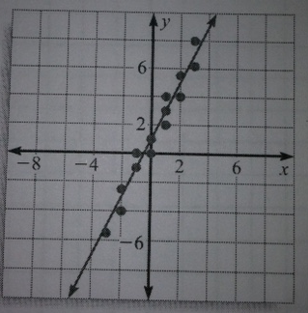
An example of fitting a line to data
The purpose of this lesson is to learn how to write a linear model to represent a collection of data. Since there is no linear model that will pass through all data points in a set, then students will create the line of best fit.
Along with the line of best fit, it is equally important to understand the correlation. Correlation is the number that indicates how well a particular set of data can be approximated by a straight line. Correlation is either positive, negative, or there is relatively no correlation.

Slide 3
Goals and Objectives
Goals
The student will find a linear equation that approximates a set of data points.
The student will determine the correlation of a real-life data.
Objectives
Given a set of data, the student will find a linear equation that best fits the students data with 100% accuracy.
Given a student created scatter plot, the student will determine the correlation of the data with 100% accuracy.

Slide 4
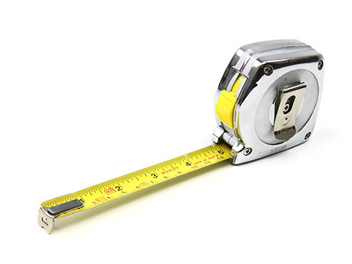
Materials
Measuring Tape
Graphing Paper
Data Collection Sheet
Ruler

Slide 5
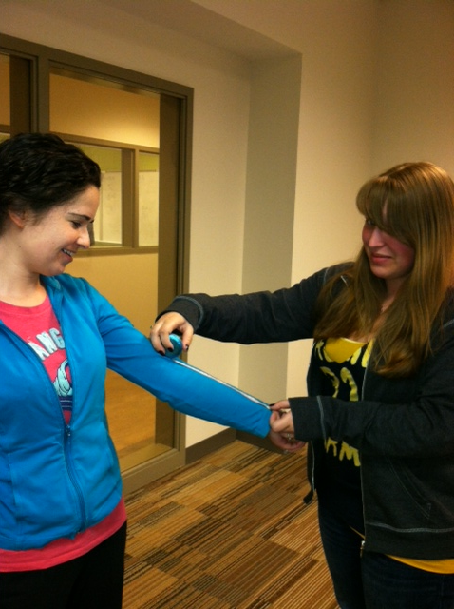
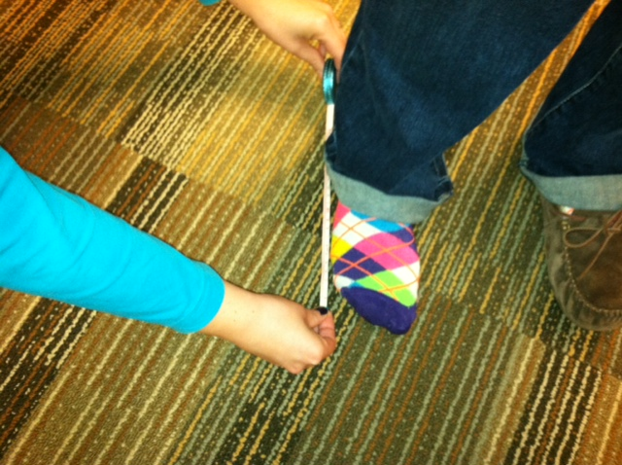
Procedure
A. Collect the Data
The class will be split up into groups of four to six students.
Each team will receive a measuring tape, graph paper, and the data collection sheet.
One by one each member in the group will measure the length of their feet (in inches) and their forearm (in inches). Shoes cannot be worn!
Once all of the heights are recorded each team will create a scatter plot. The x-axis will be the foot size and the y-axis will be the height. Make sure everything is labeled!

Slide 6
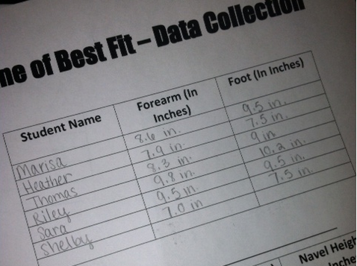
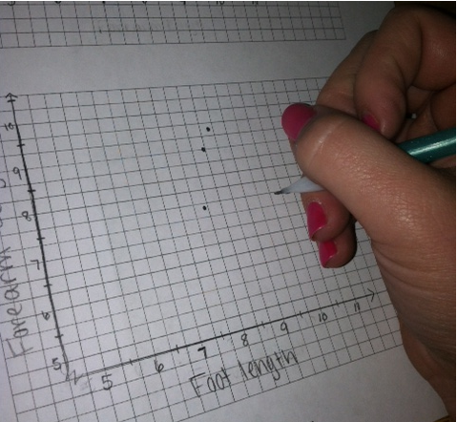
Procedure
Collect the Data

Slide 7
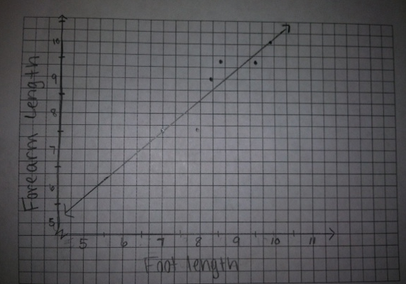
Procedure
B. Find the Line of Best Fit
With all of the data collected, each group will draw a straight line on you scatter plot that goes through as many points as possible. Sketch a line that seems to fit the data best.

Slide 8
How to Determine Line of Best Fit
B. Find the Line of Best Fit
With your line drawn, each group will determine an equation to find the line of best fit. (y=mx+b)
In order to find your equation pick points that lay on your line or very close to the line you have drawn.
Find two points that lie on the line. Points (7,7.5) and (9.8,10.2). Find the slope of the line through these points.
m= Y2-Y1 m= 10.2-7.5 m = 27 m≈.964
X2-X1 9.8-7 28
To find the y-intercept of the line, substitute the values m=.964, x=7, y=7.5 in the slope intercept form.
y = m(x) + b 7.5 = .964(7) + b 7.5 = 6.748 + b
b = .752
Therefore, an approximate equation of the best fitting line is
y = 0.964x + .752

Slide 9
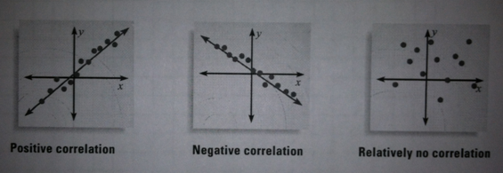
Procedure
C. Analyze the Data
Determine if there is a correlation between the length of your foot and the length of your forearm.
Make predictions using your equation.
Correlation is represented by the letter r, and can be negative, positive, or no correlation.
The correlation of our graph is POSITIVE!

Slide 10
Extended Questions
Determine the length of a person’s foot if they have a forearm length of 6 inches.
*Plug into our equation*
y = 0.964x + .752
We know the forearm length is our (y)
6 = 0.964x + .752
Solve for (x)
6 - .752 = 0.964x
5.248 = 0.964x
X ≈ 5.4
If a person has a forearm length of 6 inches long their foot length would be 5.4 inches long.

Slide 11
Extended Questions
Determine the length of a person’s forearm if the length of their foot is 25 inches long.
*Plug into our equation*
y = 0.964x + .752
We know the foot length is our (x)
y = 0.964*(25) + .752
Solve for (y)
y =24.1 + .752
y = 24.852
Y ≈ 24.9
If the length of a persons foot is 25 inches long then the length of their forearm is approximately 24.9 inches long.

Slide 12
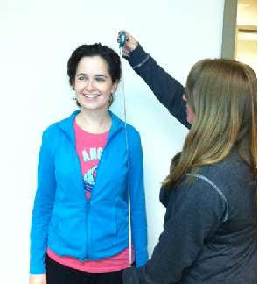
Extended Exercises
Determine the correlation and line of best fit for height and height of navel from the ground.
Determine the correlation of arm span, from finger to finger, and the height of a person.

Slide 13
Standards Addressed
Students will recognize, use, and represent algebraically patterns, relations, and functions.
A.A.35 Write the equation of a line, given the coordinates of two points on the line.
A.A.37 Determine the slope of a line, given its equation in any form.
Students will understand how mathematical ideas interconnect and build on one another to produce a coherent whole.
A.CN.3 Model situations mathematically, using representations to draw conclusions and formulate new situations A.CN.4
Understand how concepts, procedures, and mathematical results in one area of mathematics can be used to solve problems in other areas of mathematics
Students will recognize and apply mathematics in contexts outside of mathematics.
Students will create and use representations to organize, record, and communicate mathematical ideas.
A.R.1 Use physical objects, diagrams, charts, tables, graphs, symbols, equations, or objects created using technology as representations of mathematical concepts A.R.2 Recognize, compare, and use an array of representational forms

Slide 14
Resources
Fitting a Line to Data. (n.d.). Classzone. Retrieved April 23, 2012, from http://http://cphs.dadeschools.net/departments/mathematics/ebooks/alg1mcd/Source/LA105EAD.pdf
Line of Best Fit. (n.d.). MathBits. Retrieved April 24, 2012, from http://http://mathbits.com/mathbits/tisection/statistics1/linefit.htm

